Slide 1

StaySafeMedical.com Hospital Management System
By
Chowdhury A Hashmee
Mahim Pritom

Slide 2




Team member information
CHOWDHURY A HASHMEE
MAHIM PRITOM
Hey I am Chowdhury Hashmee. I am doing my bachelor’s in computer systems at New York City College of Technology. For this project, my role will be project planning, analysis our business requirements and make presentation of our project.
Hi, I am Mahim Pritom. I am a senior year student majoring in Computer Systems at New York City College of Technology. For this project, my focus will be on designing, implementation, and testing.
Medical.Com

Slide 3

EXECUTIVE SUMMARY
StaySafeMedical.com is a complete hospital management system.
It will help the user from different location throughout the country.
To do this job, this system will have different types of database systems based on the requirements and performance.
Project management system will be applied to complete each task, and everything will be documented accordingly.

Slide 4

Objectives
The main goals to design & implement a database application for a Hospital Management System Application named “StaySafeMedical.com”. The application is to automate the managing of patients and hospital personnel activities etc. This system allows hospital employees to conveniently manage hospital patient activities such as assigning physicians, medical care, registration etc.
The application uses Three-Tiered Web-based Client/Server – for customers, physicians, nurses and other medical professionals to manage the day activities in the hospital online via a browser.
Two-Tiered Windows-Client Client/Server – Front line workers such as emergency room administrators, nurses, registration clerks etc.
Database Tier – both the Three-tiered Web and Two-tiered Windows client/server will SHARE the same Database tier.
It will also support dozens of major cities around the world. In addition, provide a great user experience in Hospital Reservations.
There are multiple requirements in order to complete the whole process. The Project must need planning analyzing, designing and implementing phases to successfully complete the projects.

Slide 5
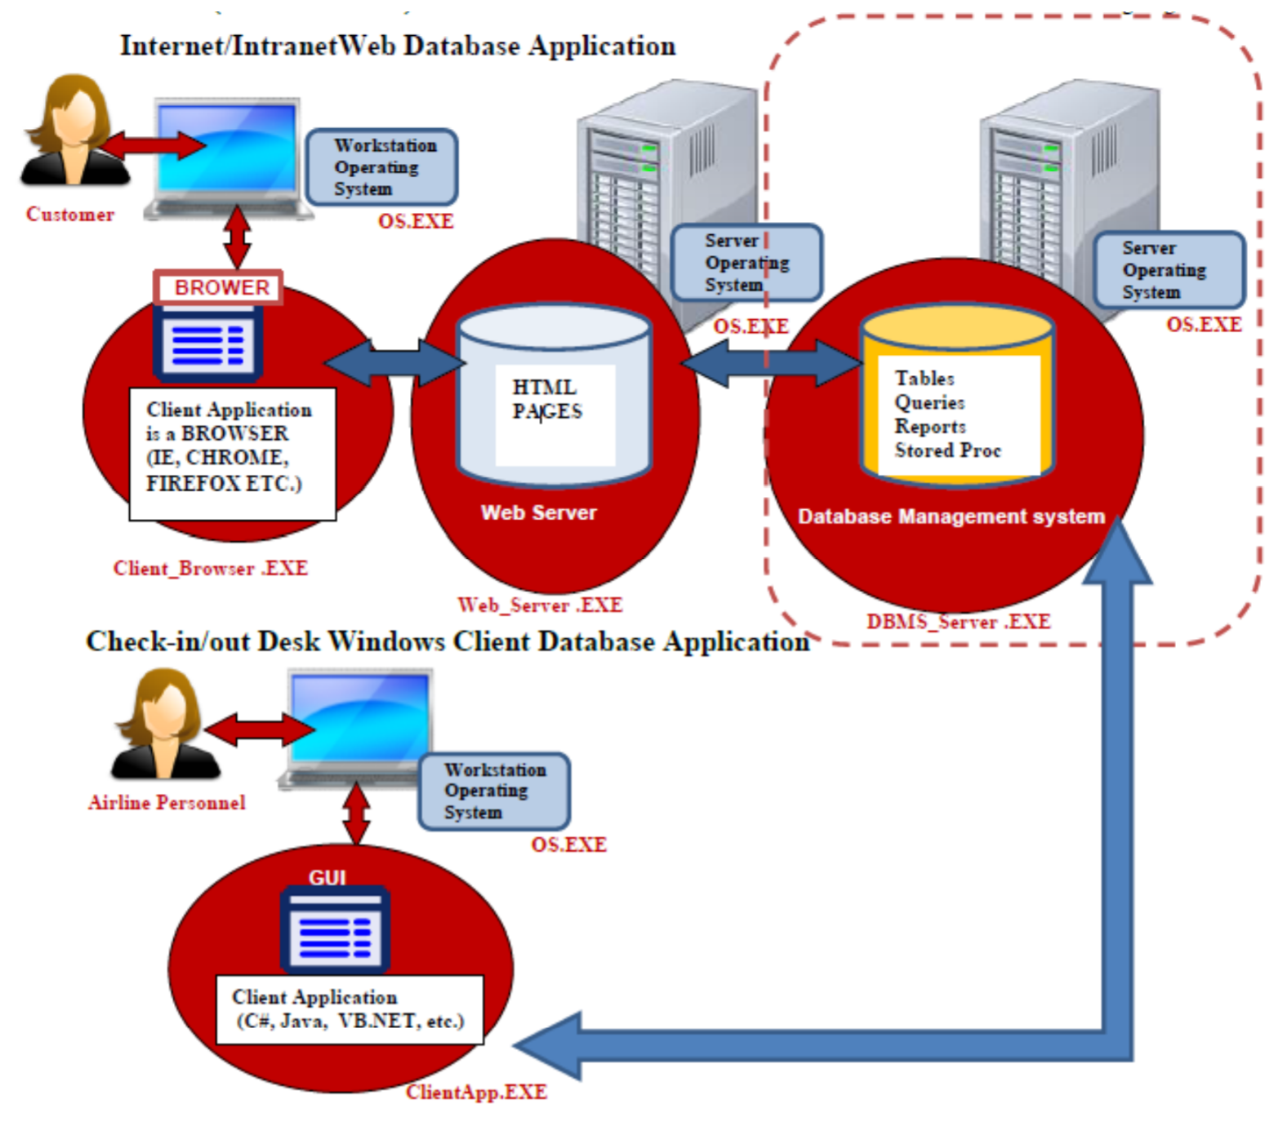
Targeted Technical Architecture
The system is a combination of 1) Three-Tiered Web Database Application with a web-based browser front-end for the users that want to make reservations via the internet or travel agency employees that require a browser-based application. In addition, we have an additional architecture: 2) Two-Tiered Windows Database Application, with a custom client front-end to for the application used by check-in desk at the airports and other airline users that require fast performance. Note that both these architecture (Web & Custom client) share the same DBMS back-end data store. Here is the full architecture we are targeting.

Slide 6
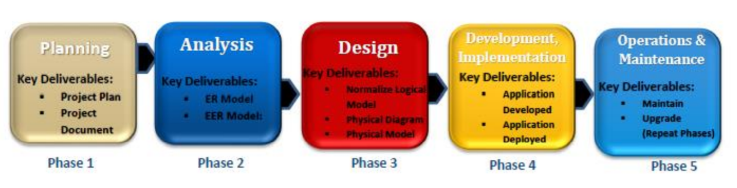
Targeted Methodology & Plan
Planning: Plan the entire project from a high-level. Gather requirements from business. Decide on methodology etc.
Analysis: Analyze the business or organization in order to determine requirements for developing database. Deep analysis of requirements.
Design: Organize all the requirements and produce a detailed specification of all data, forms, reports, displays, and processing or business rules. This includes purchase of all hardware, software etc.
Implementation: Create the database, tables, view, stored procedures etc. Create Front-End Client programs. Test and install system, train users and document the installation and Standard Operation Procedures (SOP).
Maintenance/Administration: Monitor, backup & repair the system. Periodically audit system to ensure it continues to meet requirements. Have a disaster/recovery system in place. (Excluded from our project)

Slide 7
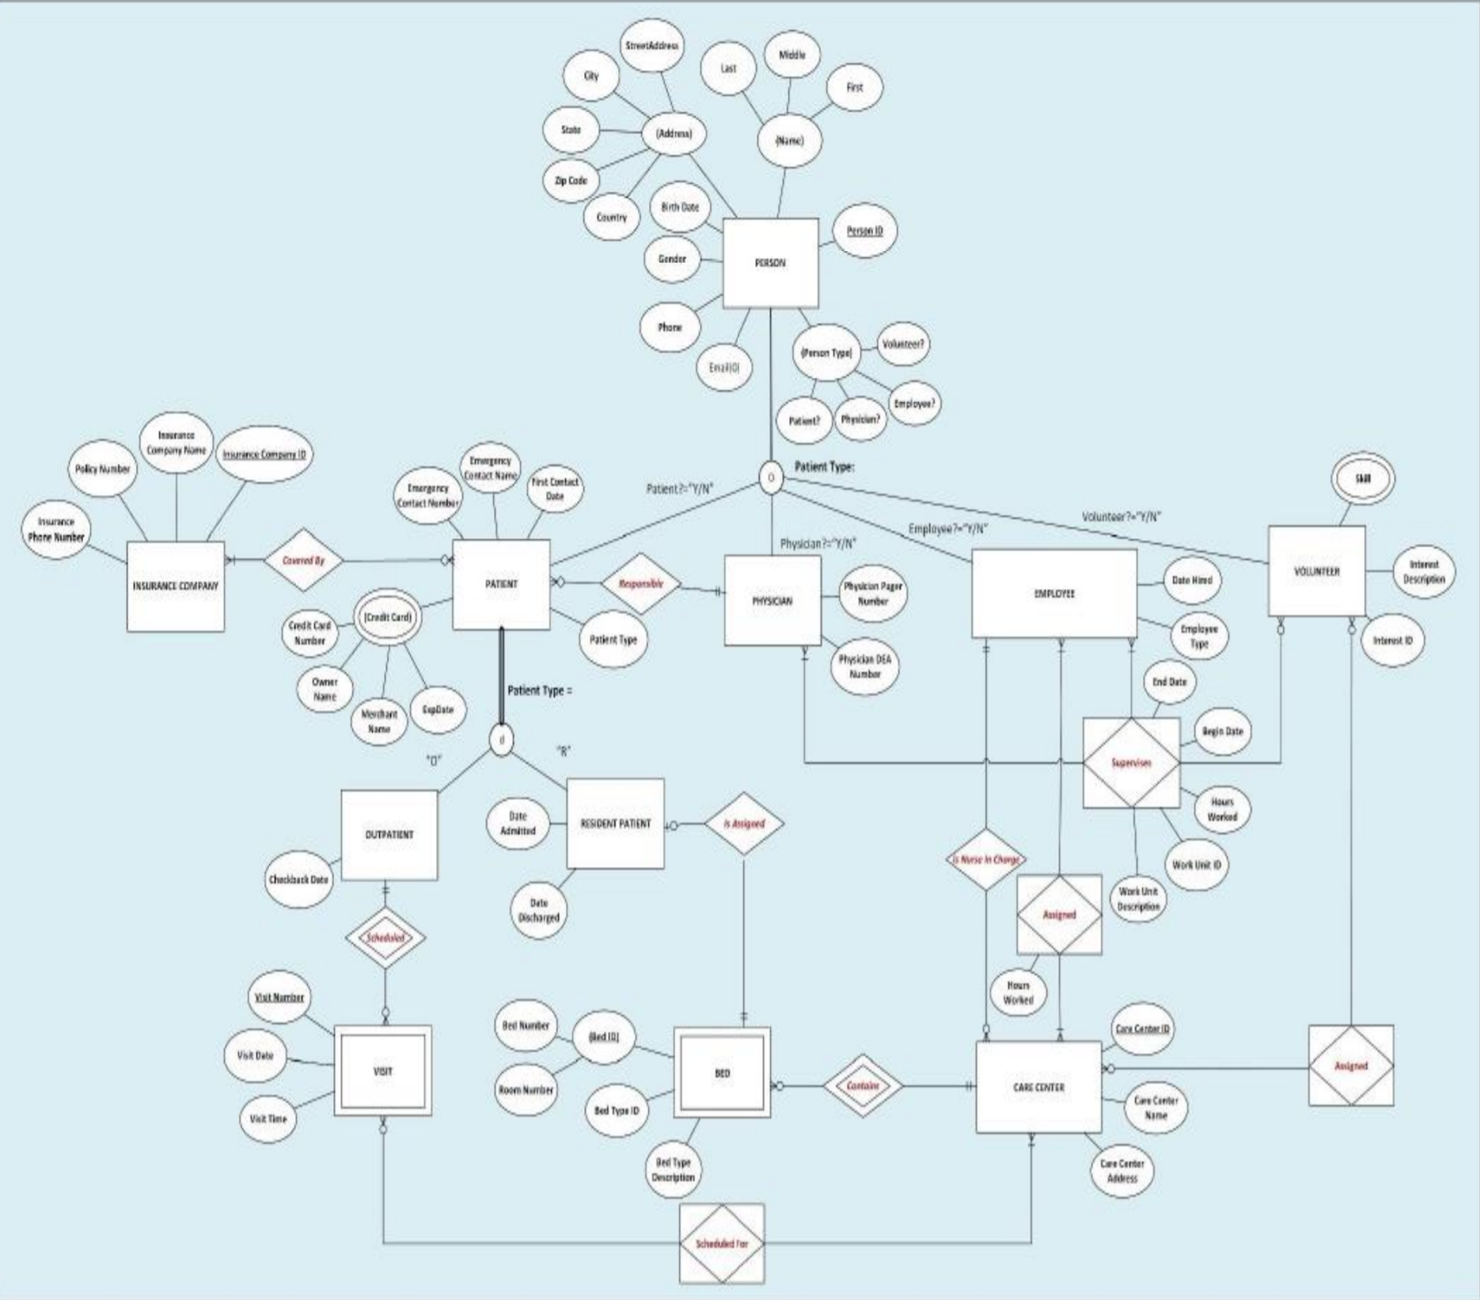
EER Conceptual Model
Here is our Enterprise ERD Model based on the business requirement:

Slide 8
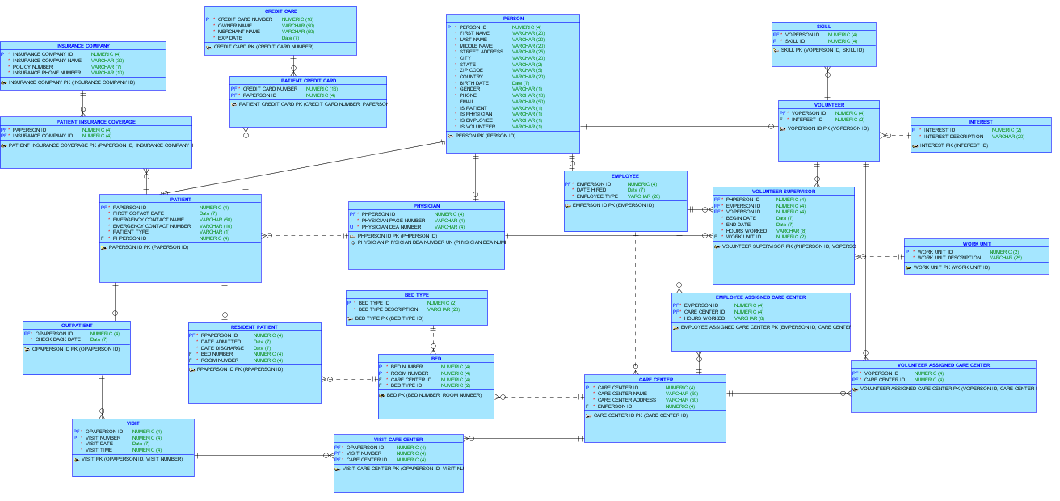
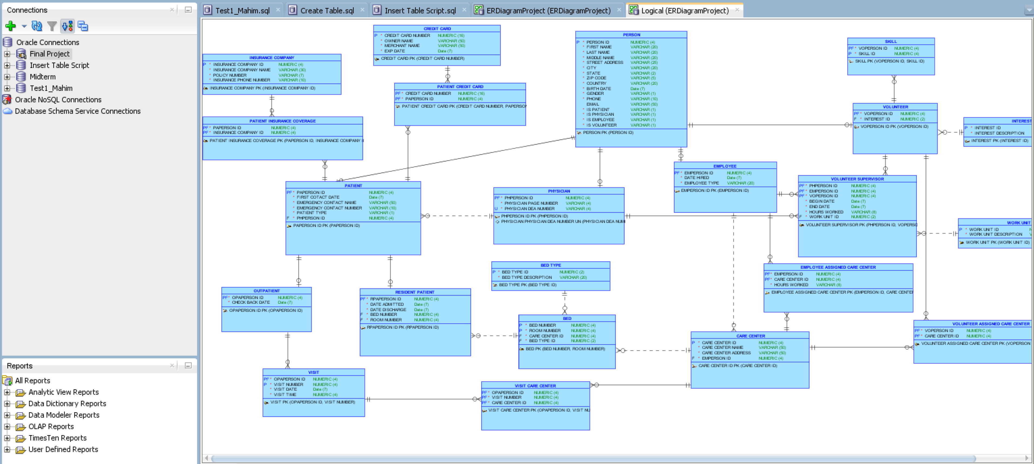
Normalized Logical Model
Here is the normalized logical model based on the conceptual ERD:

Slide 9
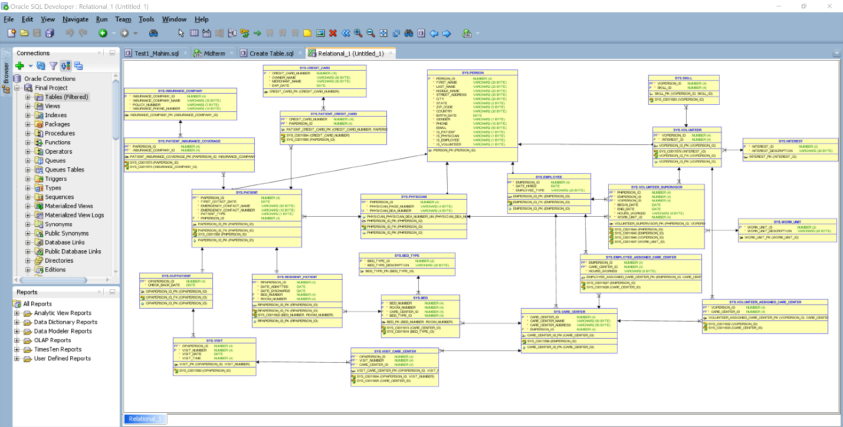
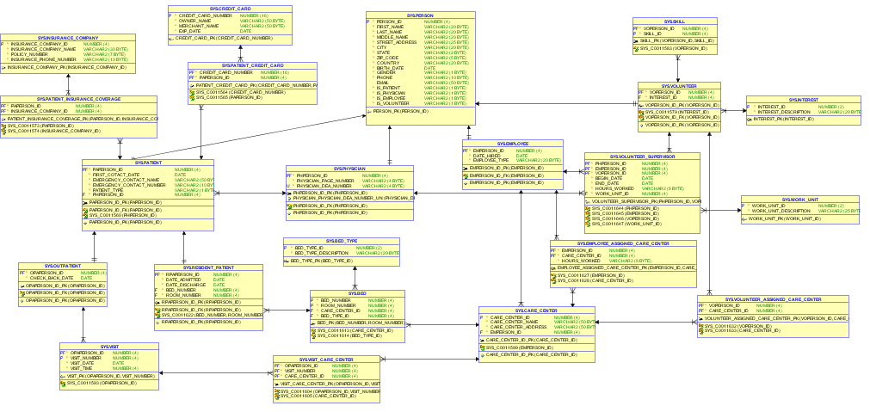
Physical Model Schema Diagram
Here is the Physical Model Schema Diagram based on the Data Dictionary:

Slide 10
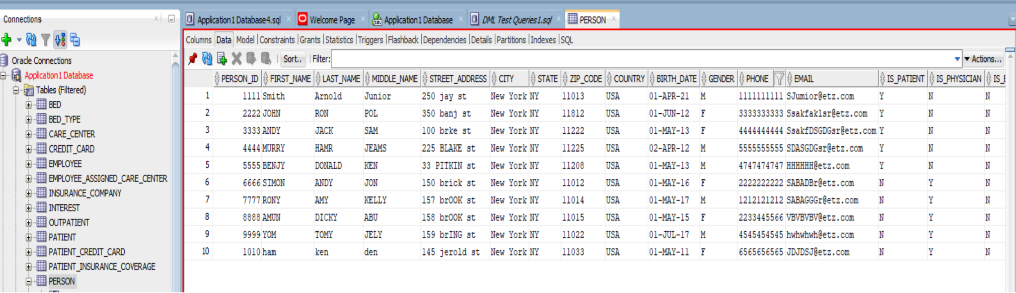
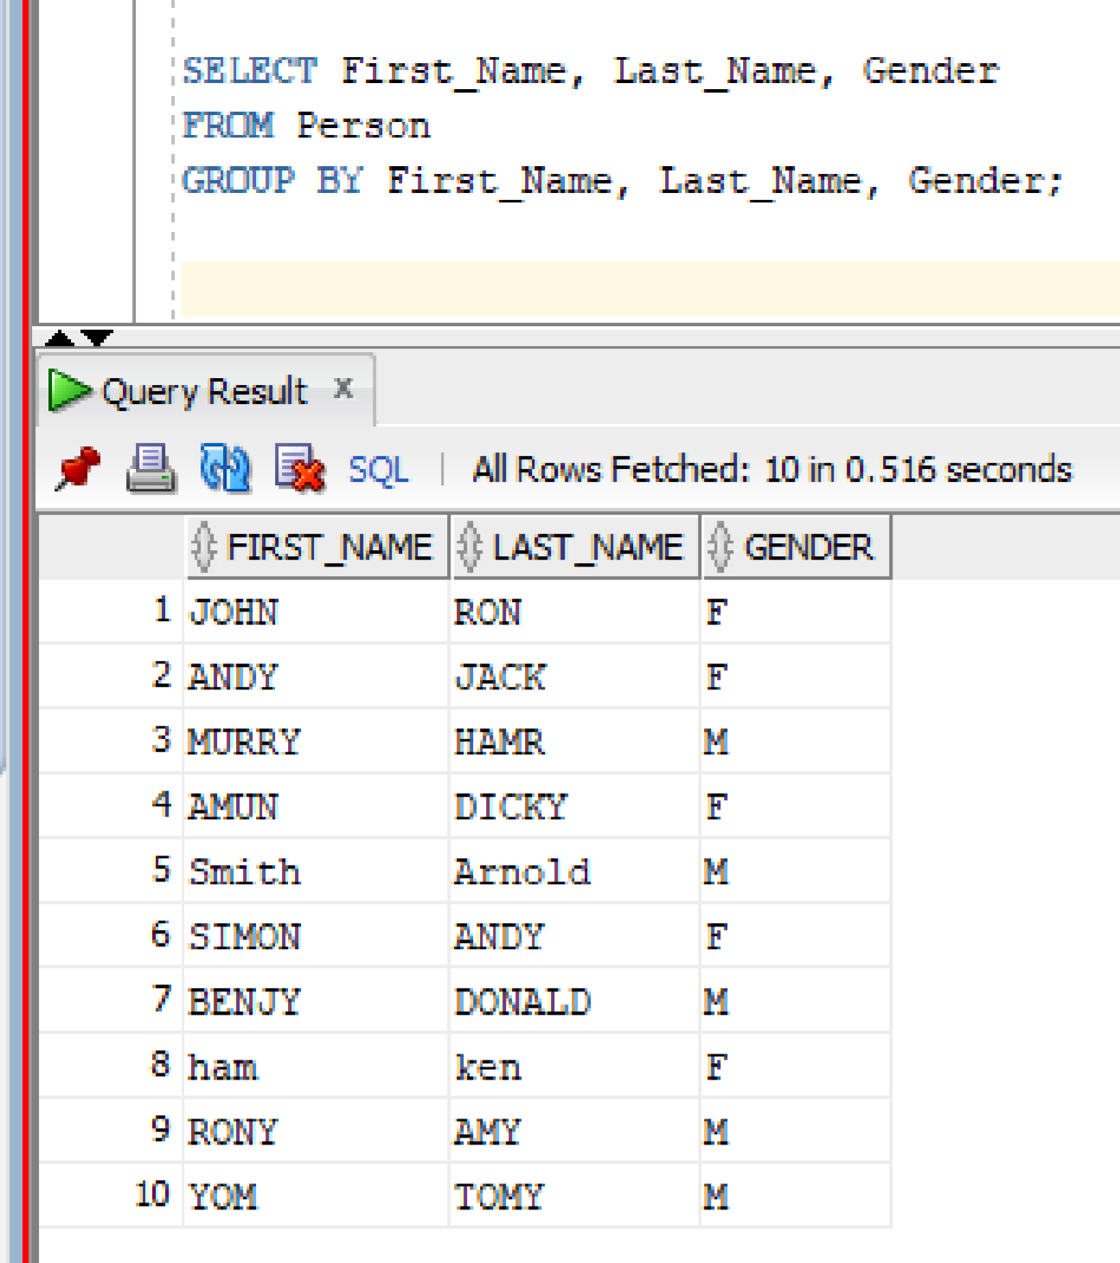
Testing and Validating Via Queries
Here we have given two examples from testing and validating via queries.
The first picture on the top is the person table data inserted.
The second picture in the bottom is displaying multiple records based on criteria.

Slide 11
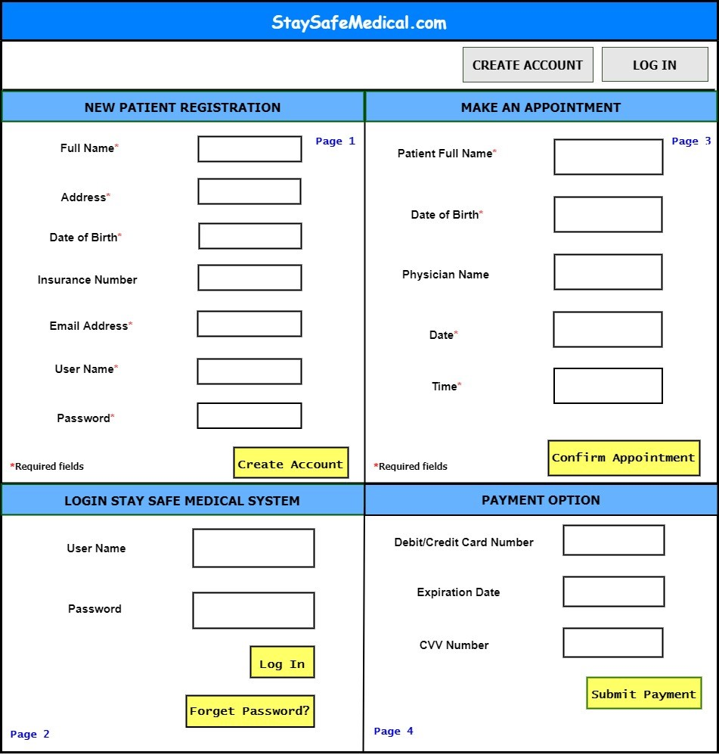
User Interface
Here is the user interface for StaySafeMedical.com management system:

Slide 12

CONCLUSION
StaySafeMedical.com is a convenient and user-friendly Application for the Hospital management system.
It will automate the managing of patients and hospital personnel activities in the fastest and easiest way.
It will store the data and track all the employees from major cities. To do this job all the project management methodology like planning, analyzing, designing is applied and documented properly.

